Slide 1
No. 1

Slide 2

STATISTICS

Slide 3
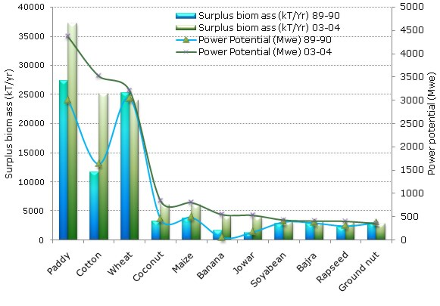
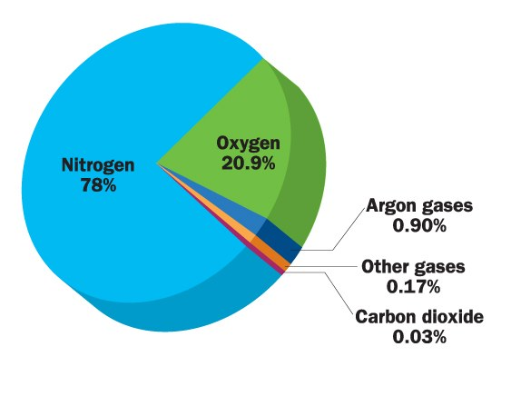
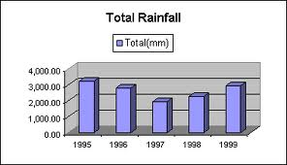
Where have we seen statistics?
We have seen use of statistics in our textbooks & newspapers as well as on tv the following clips are some of the examples
Growth of crops is shown in this diagram
The presence of different gases in air is shown in the diagram
Rain fall for different years is shown

Slide 4
What is Statistics ?
Collection
Presentation
Analysis
Conclusion

Slide 5
Q. Give five examples of data that you can collect from your day to day life.
Sol.
Five examples of data that we can gather from our day to day life are :
(i) Number of students in our class.
(ii) Number of fans in our school.
(iii) Electricity bills of our house for last two years.
(iv) Election results obtained from television or newspapers.
(v) Literacy rate figures obtained from Educational Survey.
Of course, remember that there can be many more different answers.
Q. Classify the data in Q.1 above as primary or secondary data
Sol.
Primary data ;
(i), (ii) and (iii)
Secondary data;
(iv) and (v).
Primary data : When the information is collected by the investigator himself with a definite
objective in his mind.
Secondary data: When the information is gathered from a source which already had the
information stored this data which has been collected by someone else.

Slide 6
No. 2

Slide 7
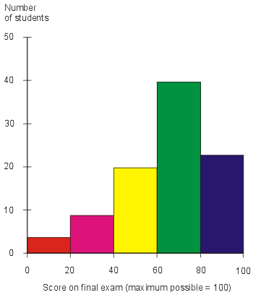
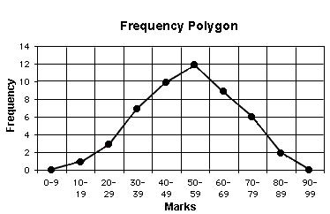
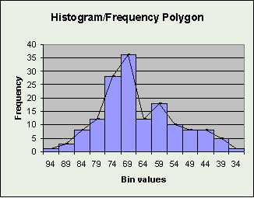
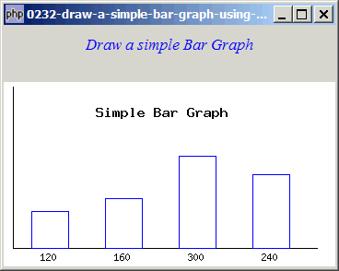
Types of Presentation
Numerical Presentation
Graphical Presentation
Diagrammatic Presentation
Arranging Data in Ascending
or Descending order
Histogram
Bar diagram
Frequency polygon
Age in Years | Frequency
12 | 9
13 | 6
14 | 3
15 | 0
16 | 2
Age in Years | Frequency
0 – 10 | 9
10 – 20 | 6
20 – 30 | 3
30 – 40 | 0
40 – 50 | 2
Ungrouped frequency
Distribution table
Age in Years | Frequency
1 – 10 | 9
11 – 20 | 6
21 – 30 | 3
31 – 40 | 0
41 – 50 | 2
Grouped frequency
Distribution table

Slide 8

INTRODUCTION
In our daily life we come across some situations like finding lengths, areas and volumes of the objects in consideration.
NUMERICAL PRESENTATION
Arranging the data in ascending or descending order. In which we have to, remember one very important term ‘Range of data’.
Range of data
Maximum value
Minimum value

Slide 9
For e.g.
Ungrouped Frequency Distribution Table
Ages of some students are collected as follows :
13,
12,
13,
12,
13,
12,
14,
12,
14,
In this method we have to prepare a table having three columns.
In the first column, we write the heading regarding the data
in the second column the heading is tally marks
third column is frequency.
12,
13,
12,
13,
12,
14,
13,
Find the biggest number
Find the smallest number
Age in years
Tally Marks
Frequency
In the first column we write all the numbers in the data starting from the smallest to the biggest once only.
14
12
In the tally marks column we put sticks like this
Frequency is number of tally marks we put
12
7
13
Let us draw tally marks for given data
6
Let us count tally marks for each class
We make a set of 5 this way
14
3
Total (N)
16
These sticks represent the number of times the data item occurs in the list

Slide 10
Q. The blood groups of 30 students of Class VIII are recorded as follows :
A, B, O, O, AB,O, A, O, B, A, O, B, A, O, O
A, AB,O, A, A, O, O, AB, B, A, O, B, A, B, O
the different blood groups given are
In the second column we write tally marks & in third column we write frequency
In the first column we write the different blood groups once one below the other
A,
B,
O,
AB,
Represent this data in the form of a frequency distribution table. Which is the most
common and which is the rarest blood group among these students?
Sol.
Let us observe the different blood groups in the given data
The frequency distribution table is as under.
In this sum we have to prepare ungrouped frequency distribution table
Blood group
Tally marks
Number of students
A
9
Let us draw tally marks for given data
B
6
O
12
AB
3
Let us count tally marks for each class
Total
30
Clearly, most common – O, Rarest – AB.

Slide 11
No. 3

Slide 12
Q.] Three coins were tossed 30 times. Each time the number of heads occurring was noted down as follows :
0 1 2 2 1 2 3 1 3 0 1 3 1 1 2 2 0 1 2 1 3 0 0 1 1 2 3 2 2 0
Prepare a frequency distribution table for the data given above.
Sol.
Let us prepare an ungrouped frequency table
Number of heads
Tally marks
Frequency
The minimum and maximum value in given data are 0 and 3 respectively.
0
6
1
10
2
9
3
5
Total
30

Slide 13
Q.] The value of p upto 50 decimal places is given below :
3.14159265358979323846264338327950288419716939937510.
Make a frequency distribution of the digits from 0 to 9 after the decimal point.
What are the most and the least frequently occurring digits?
Digits
Tally marks
Frequency
Make an ungrouped frequency distribution of the digits from 0 to 9 after the decimal point.
0
2
Sol.
1
5
2
5
The most frequently occurring digits are 3 and 9. The least occurring is 0.
3
8
4
4
5
5
6
4
7
4
8
5
9
8
Total
50

Slide 14
No. 4

Slide 15
Grouped frequency Distribution Table
In the first column, the data is classified into small groups each group is called as a class.
In this method we prepare a table with three columns.
in the second column the heading is tally marks
third column is
frequency.
every class has its own lower limit and its own upper limit.
For e.g. 0-10, 10-20 etc. each one i.e. 0-10, 10-20, 20-30 is called as a class
Lower limit
Upper
limit
A data of marks obtained by
some students in Maths are
collected as follows
Class ( Marks obtained)
Not same
Tally Marks
Frequency
If we have to prepare grouped
frequency table taking classes
1 – 10
11
11 – 20
11
21 – 30
18
Total
40
The classes are called dis-continuous classes.

Slide 16
Grouped frequency Distribution Table
In the first column, the data is classified into small groups each group is called as a class.
in the second column the heading is tally marks
third column is
frequency.
In this method we prepare a table with three columns.
Lower limit
Upper limit
Class ( Marks obtained)
Same
Tally Marks
Frequency
When the classes are
continuous we follow law of
excluding upper limits.
0 – 10
7
10 – 20
13
i.e. for class 0-10 , 10 is the
upper limit so tally mark for
10 is recorded in the next class
10-20.
20 – 30
14
30 – 40
6
Total
40
The classes are called continuous classes.

Slide 17
No. 5

Slide 18
Q. The distance (in km) of 40 engineers from their
residence to their place of work were found
as follows :
Distances (in km)
Tally marks
Frequency
5 3 10 20 25 11 13 7 12 31
19 10 12 17 18 11 32 17 16 2
7 9 7 8 3 5 12 15 18 3
12 14 2 9 6 15 15 7 6 12
0 – 5
5
5 – 10
11
10 – 15
11
Construct a grouped frequency distribution table with class size 5 for the data given above, taking the first interval as 0 – 5 (5 not included). What main features do you observe from this tabular representation?
15 – 20
9
20 – 25
1
25 – 30
1
Sol.
The 1st class interval is 0 -5
30 – 35
2
Most of the Engineers resides in the range of less than 20kms from their work place
Since 5 is not included in class 0 -5
Total
40
The classes are continuous
Since the size of all the classes is same
Since the biggest no. in the data
is 32 the last class will be 30 - 35
The class intervals are 0- 5, 5- 10, 10 – 15…

Slide 19
No. 6

Slide 20
Q. The relative humidity (in %) of a certain city
for a month of 30 days was as follows :
Relative humidity
(in %)
Tally marks
Frequency
98.1 98.6 99.2 90.3 86.5 95.3 92.9 96.3
94.2 95.1 89.2 92.3 97.1 93.5 92.7 95.1
97.2 93.3 95.2 97.3 96.2 92.1 84.9 90.2
95.7 98.3 97.3 96.1 92.1 89
84 – 86
1
86 – 88
1
Construct a grouped frequency distribution
table with classes 84 – 86, 86 – 88 etc.
88 – 90
2
90 – 92
2
Sol.
92 – 94
7
Since the classes given are 84 -86, 86 -88 …
The classes are continuous and also their size is the same
94 – 96
6
96 – 98
7
Since the biggest no.in the data is 99.2
The last class will be 98 - 100
98 – 100
4
Total
30

Slide 21
Q. The relative humidity (in %) of a certain city
for a month of 30 days was as follows :
Relative humidity
(in %)
Tally marks
Frequency
98.1 98.6 99.2 90.3 86.5 95.3 92.9 96.3
94.2 95.1 89.2 92.3 97.1 93.5 92.7 95.1
97.2 93.3 95.2 97.3 96.2 92.1 84.9 90.2
95.7 98.3 97.3 96.1 92.1 89
84 – 86
1
86 – 88
1
88 – 90
2
Which month or season do you think this
data is about?
90 – 92
2
Sol.
7
92 – 94
(ii) The data appears to be taken in the rainy
season as the relative humidity is high.
94 – 96
6
96 – 98
7
98 – 100
4
Total
30

Slide 22
Q. The relative humidity (in %) of a certain city
for a month of 30 days was as follows :
Relative humidity
(in %)
Tally marks
Frequency
98.1 98.6 99.2 90.3 86.5 95.3 92.9 96.3
94.2 95.1 89.2 92.3 97.1 93.5 92.7 95.1
97.2 93.3 95.2 97.3 96.2 92.1 84.9 90.2
95.7 98.3 97.3 96.1 92.1 89
84 – 86
1
86 – 88
1
88 – 90
2
Range of the data = Maximum value – Minimum value
(iii) What is the range of this data?
90 – 92
2
Sol.
7
92 – 94
99.2
84.9
(iii) Range =
–
=
14.3 (in %)
94 – 96
6
96 – 98
7
98 – 100
4
Total
30

Slide 23
No. 7

Slide 24
Q.] The heights of 50 students, measured to the nearest centimetre
have been found to be as follows :
161 150 154 165 168 161 154 162 150 151 162 164 171 165 158 154 156 172 160
170 153 159 161 170 162 165 166 168 165 164 154 152 153 156 158 162 160 161 173 166 161 159 162 167 168 159 158 153 154 159
Represent the data given above by a grouped
frequency distribution table, taking the class
intervals as 160 – 165, 165 – 170, etc.
What can you conclude about their heights from
the table?
Heights (in cm)
Tally marks
Frequency
150 – 155
12
155 – 160
9
Sol.
160 – 165
14
The minimum and maximum heights in the given raw
data are 150 cm and 173 cm respectively.
165 – 170
10
One conclusion that we can draw from the
above table is that more than 50 % of students
are shorter than 165 cm.
It is given that 160 – 165 is one of the class intervals Since class size is same.
170 – 175
5
Total
50
So, the classes of equal size are 150 – 155, 155 – 160, ..., 170 – 175.

Slide 25
Thank You

